Slide 1
Factors associated with differences in Life Expectancy across the United States
Tonia Chu
Under the mentorship: Srdjan Santic
For the course: Data Science Career Track (Springboard)

Slide 2
Content
Introduction
Dataset
Data Analysis
Data Modeling
Analysis Results
Future Work

Slide 3
Introduction
In this project, I want to solve following problems:
What is the shape of the income–life expectancy gradient?
How are gaps in life expectancy changing over time?
How do the gaps vary across local areas?
What are the factors associated with differences in life expectancy?

Slide 4
Dataset
The dataset include 14 csv files of data tables.
Data Table 1: National life expectancy estimates (pooling 2001-14) for men and women, by income percentile
Data Table 2: National by-year life expectancy estimates for men and women, by income percentile
Data Table 3: State-level life expectancy estimates for men and women, by income quartile
Data Table 4: State-level estimates of trends in life expectancy for men and women, by income quartile
Data Table 5: State-level by-year life expectancy estimates for men and women, by income quartile
Data Table 6: CZ-level life expectancy estimates for men and women, by income quartile
Data Table 7: CZ-level life expectancy estimates for men and women, by income ventile
Data Table 8: CZ-level estimates of trends in life expectancy for men and women, by income quartile
Data Table 9: CZ-level by-year life expectancy estimates for men and women, by income quartile
Data Table 10: CZ-level characteristics described in eTable 9
Data Table 11: County-level life expectancy estimates for men and women, by income quartile
Data Table 12: County-level characteristics described in eTable 11
Data Table 13: International estimates of mean life expectancy at age 40, by country for men and women
Data Table 14: Comparison of population and death counts in tax data and NCHS data

Slide 5
Data Wrangling
Remove the unadjusted and Standard Error columns in the tables
Fill missing values in table 10 and table 12
There are 3 steps to fill missing values in table 12:
A county is removed if all the values of a column are missing.
A column is removed if there are more than 20% missing value.
Fill missing values with the mean value of that that county.

Slide 6
Exploratory Data Analysis
1. National Levels of Life Expectancy by Income
2. National Trends in Life Expectancy by Income in year 2001~2014
3. Local Area Variation in Life Expectancy gap by Income

Slide 7
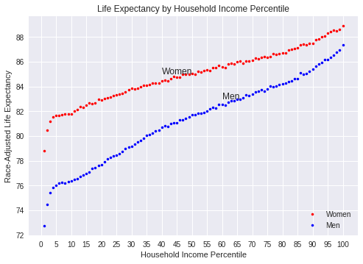
National Levels of Life Expectancy by Income

Slide 8
National Levels of Life Expectancy by Income
Women, Bottom 1%: 78.8
Women, Top 1%: 88.9
Women, Life expectancy gap: 10.1
Men, Bottom 1%: 72.7
Men, Top 1%: 87.3
Men, Life expectancy gap: 14.6

Slide 9
National Levels of Life Expectancy by Income
Gender gap, Bottom 1%: 6.0
Gender gap, Top 1%: 1.5
Women, Slope of linear regression: 0.07
Men, Slope of linear regression: 0.11

Slide 10
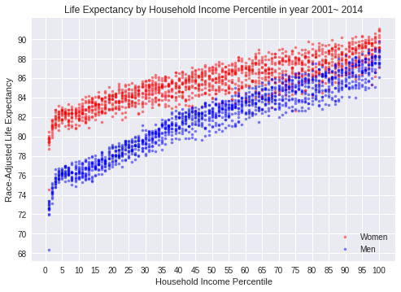
National Trends in Life Expectancy by Income in year 2001~2014

Slide 11
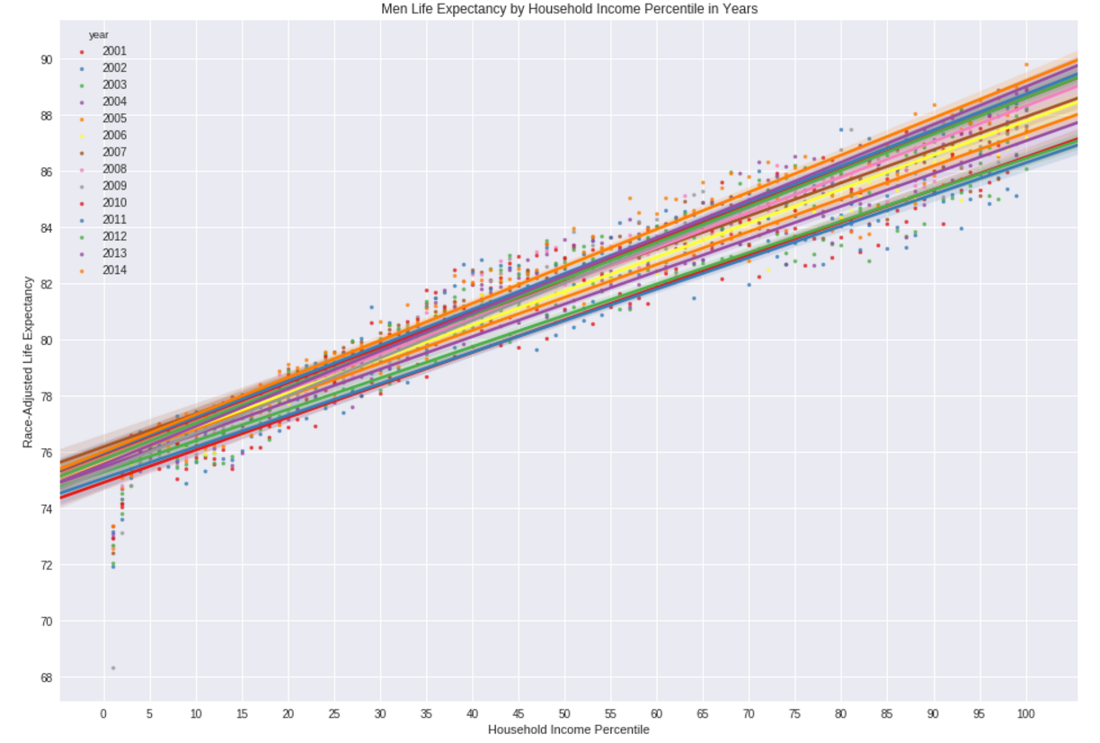
Men Life Expectancy by Household Income Percentile in year 2001~2014

Slide 12
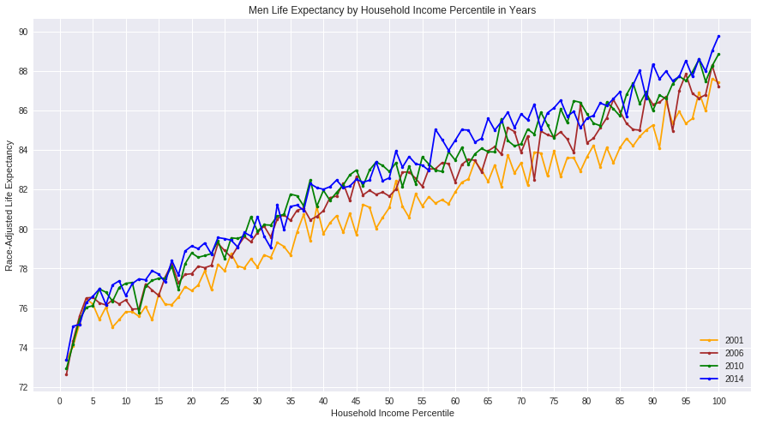
Men Life Expectancy by Household Income Percentile in Years

Slide 13
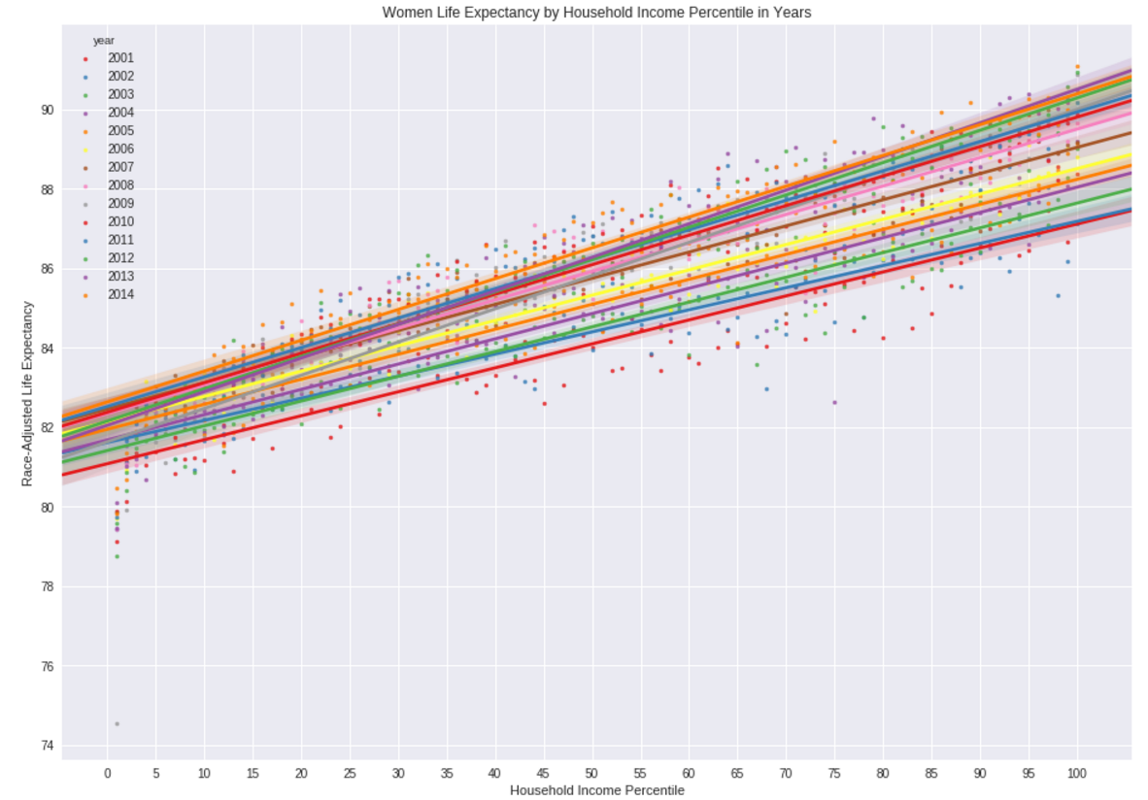
Women Life Expectancy by Household Income Percentile in year 2001~2014

Slide 14
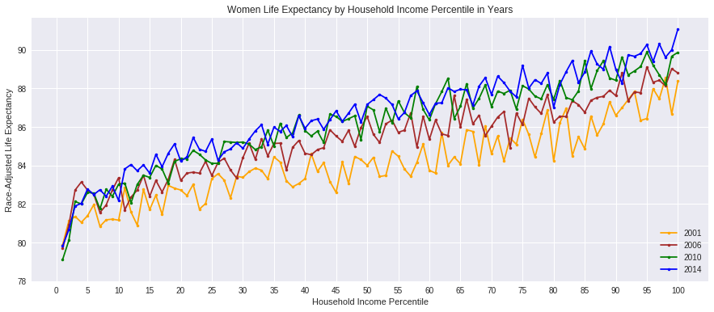
Women Life Expectancy by Household Income Percentile in Years

Slide 15
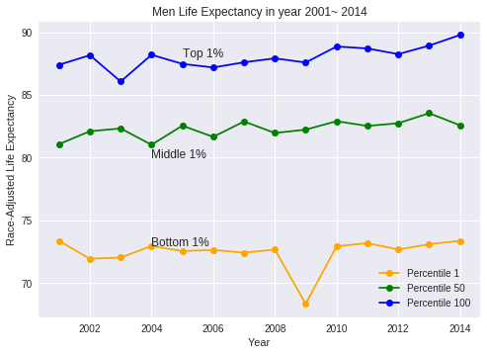
Men Life Expectancy Trend in Years 2001~2014
Men, Bottom 1%,
Life expectancy change: -0.1
Men, Top 1%,
Life expectancy change: 2.4

Slide 16
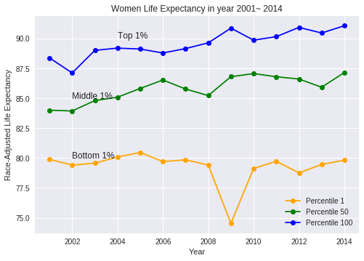
Women Life Expectancy Trend in Years 2001~2014
Women, Bottom 1%,
Life expectancy change: -0.1
Women, Top 1%,
Life expectancy change: 2.7

Slide 17
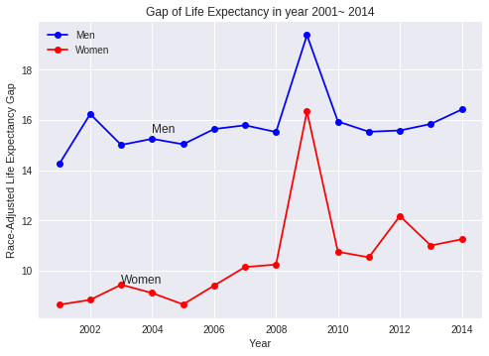
Life Expectancy Gap Trend in Years 2001~2014

Slide 18
Local Area Variation in Life Expectancy Gap by Income
How do the gaps vary across local areas?
Life Expectancy gap by State
Life Expectancy gap by Commuting Zone

Slide 19
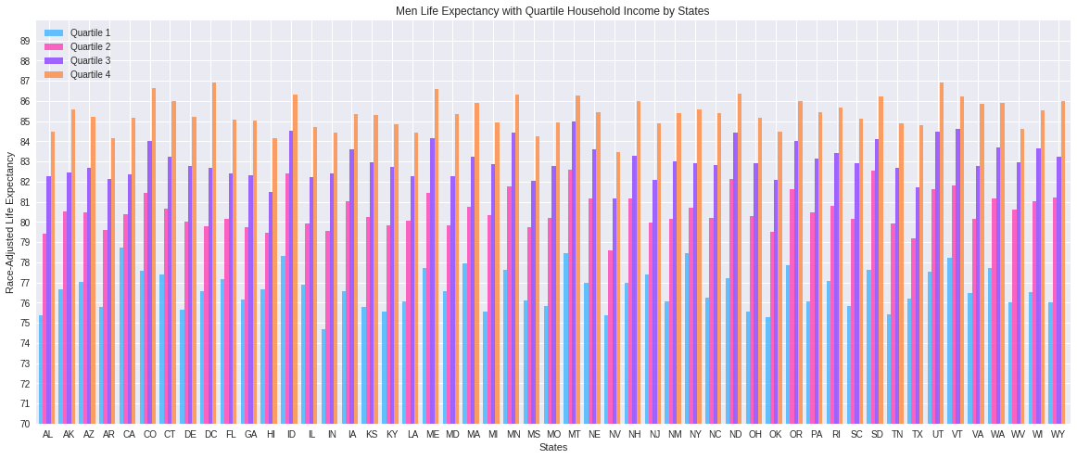
Life Expectancy gap by State
Notes:
From above figures, we can see that life expectancy of different states vary a lot.

Slide 20
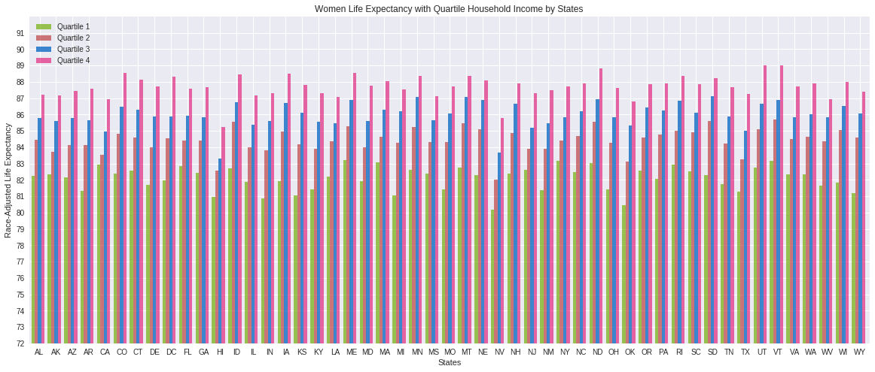
Life Expectancy gap by State
Notes:
From above figures, we can see that life expectancy of different states vary a lot.

Slide 21
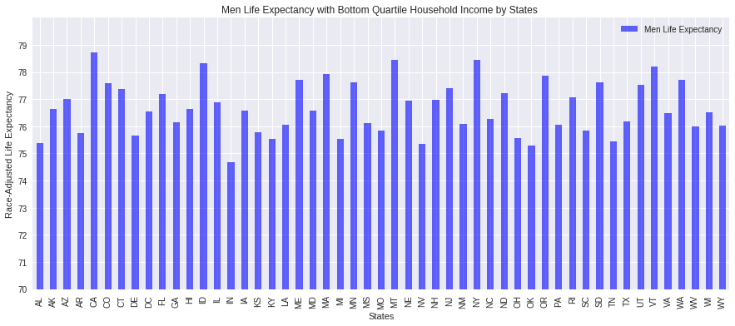
Life Expectancy of Q1 by State

Slide 22
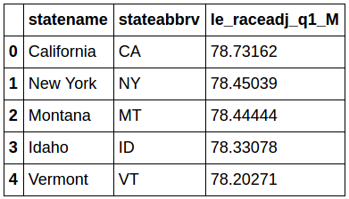
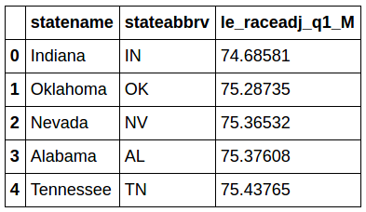
Life Expectancy of Q1 by State
5 states with the highest men life expectancy of bottom quartile income
5 states with the lowest men life expectancy of bottom quartile income

Slide 23
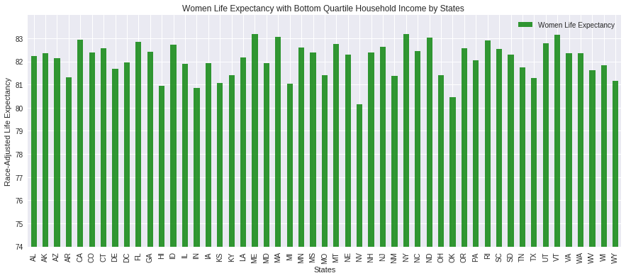
Life Expectancy of Q1 by State

Slide 24
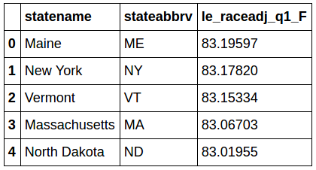
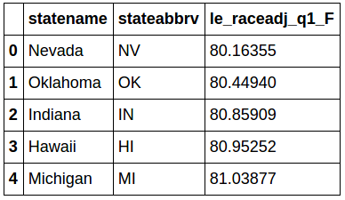
Life Expectancy of Q1 by State
5 states with the highest women life expectancy of bottom quartile income
5 states with the lowest women life expectancy of bottom quartile income

Slide 25
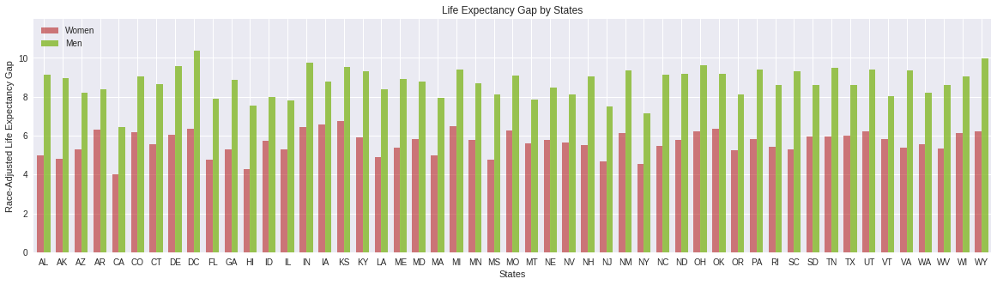
Life Expectancy gap by State
Notes:
From above figures, we can see that life expectancy of different states vary a lot.

Slide 26
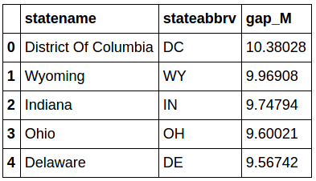
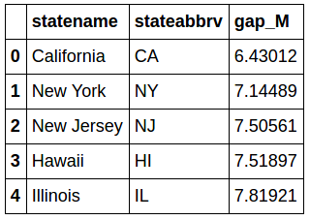
Life Expectancy gap by State
5 states with the highest life expectancy gap of men
5 states with the lowest life expectancy gap of men

Slide 27
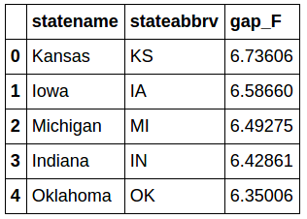
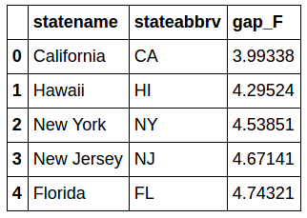
Life Expectancy gap by State
5 states with the highest life expectancy gap of women
5 states with the lowest life expectancy gap of women

Slide 28
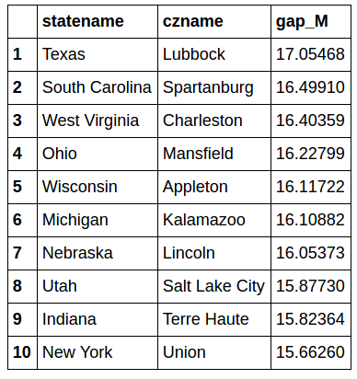
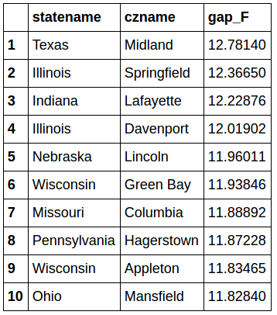
Life Expectancy gap by Commuting Zone
CZs with the highest life expectancy gap of men
CZs with the highest life expectancy gap of women

Slide 29
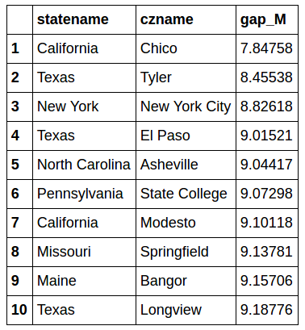
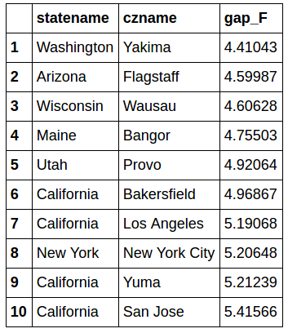
Life Expectancy gap by Commuting Zone
CZs with the lowest life expectancy gap of men
CZs with the lowest life expectancy gap of women

Slide 30
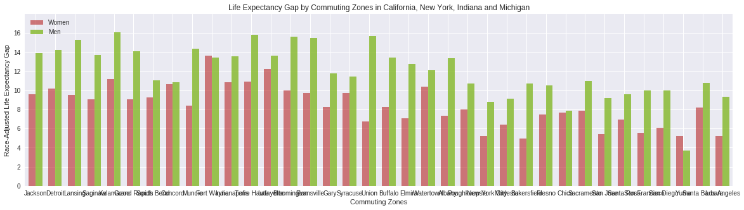
Life Expectancy gap by Commuting Zones in California, New York, Indiana and Michigan
Notes:
From above figures, we can see that life expectancy of different states vary a lot.

Slide 31
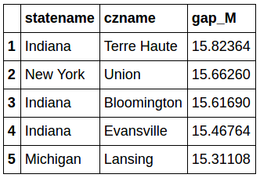
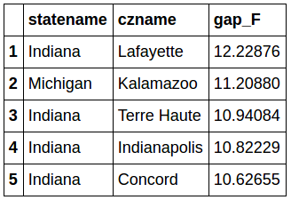
Life Expectancy gap by Commuting Zones in California, New York, Indiana and Michigan
5 CZs with the highest life expectancy gap of men
5 CZs with the highest life expectancy gap of women
Notes:
California and New York have lower life expectancy gap and Indiana has higher life expectancy gap.

Slide 32
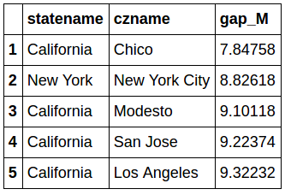
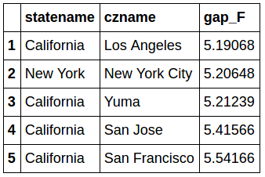
Life Expectancy gap by Commuting Zones in California, New York, Indiana and Michigan
5 CZs with the lowest life expectancy gap of men
5 CZs with the lowest life expectancy gap of women
Notes:
California and New York have lower life expectancy gap and Indiana has higher life expectancy gap.

Slide 33
Data Modeling
Find a model to predict average life expectancy of a county by factors associated with life expectancy:
Machine Learning Models
Feature Selection Methods
Factors Affect Life Expectancy

Slide 34
Machine Learning Models
Linear Regression
Support Vector Regression
Random Forest Regressor
Notes:
We use three algorithms to get the machine learning models. They are Linear Regression, Support Vector Regression, and Random Forest Regressor. For each model, we adjust the parameters, calculate Coefficient of determination R^2 of the prediction and Mean squared error (MSE) to get the best model.

Slide 35
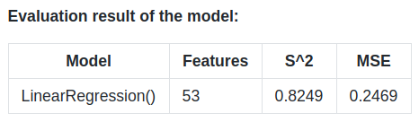
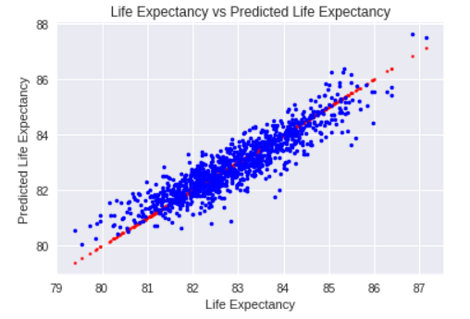
Linear Regression
Predict test dataset with the model
Fit a model X_train, and calculate MSE with y_train: 0.2399
Fit a model X_train, and calculate MSE with X_test, y_test: 0.2964

Slide 36
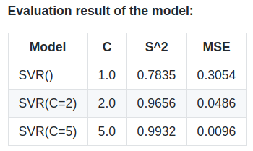
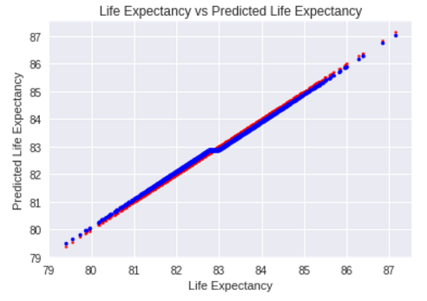
Support Vector Regression
Predict test dataset with the model
Fit a model X_train, and calculate MSE with y_train: 0.0096
Fit a model X_train, and calculate MSE with X_test, y_test: 1.4732

Slide 37
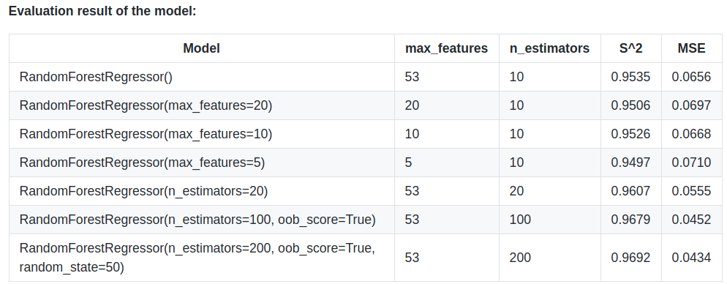
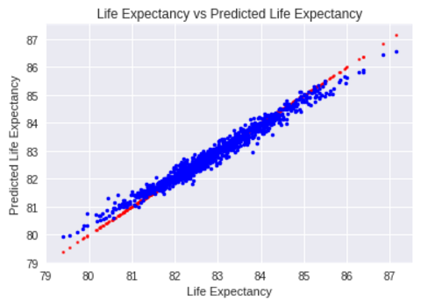
Random Forest Regressor
Predict test dataset with the model
Fit a model X_train, and calculate MSE with y_train: 0.0441
Fit a model X_train, and calculate MSE with X_test, y_test: 0.3623

Slide 38
Feature Selection Methods
Feature selection is the process of selecting a subset of relevant features for use in model construction.
Principal Component Analysis
Regularization
Random Forests
Notes:
Feature selection is the process of selecting a subset of relevant features for use in model construction. Feature selection techniques are used for four reasons:
1. simplification of models to make them easier to interpret by users,
2. shorter training times,
3. to avoid the curse of dimensionality,
4. enhanced generalization by reducing overfitting

Slide 39
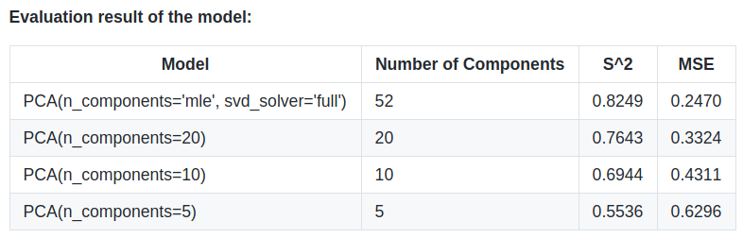
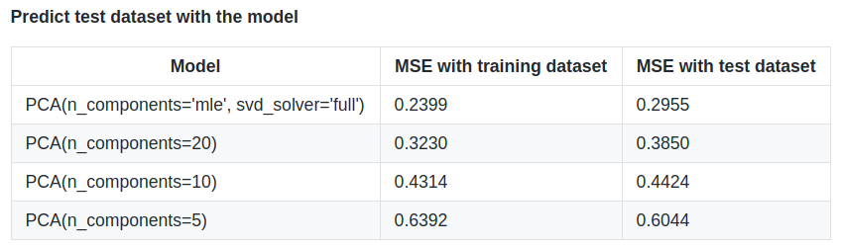
Principal Component Analysis
Principal component analysis (PCA) is a technique used to emphasize variation and bring out strong patterns in a dataset. It's often used to make data easy to explore and visualize. The number of principal components is less than or equal to the smaller of the number of original variables or the number of observations.
Notes:
Comparing MSE of the predict results on test dataset, we found that PCA Linear regression models have different predicting MSE with different parameters. MSE with training dataset is close to MSE with test dataset, so there is no overfitting problem with PCA. Consider feature number and MSE, PCA with n_components=20 is relatively good.

Slide 40
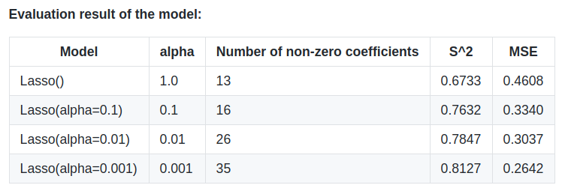
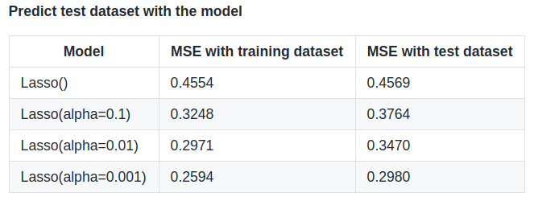
Regularization
Regularization is a technique used to avoid the overfitting problem. It is a process of introducing additional information in order to prevent overfitting. Lasso is a Linear Model trained with L1 prior as regularizer.
Notes:
From the predict results on test dataset, we found that Lasso models have different predicting MSE with different parameters. There is no overfitting problem with Lasso. MSE with training dataset is close to MSE with test dataset. Lasso with alpha=0.001 is the best model.

Slide 41
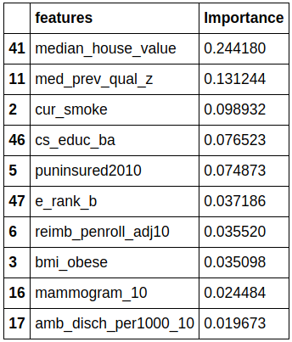
Random Forests
Random forests are among the most popular machine learning methods thanks to their relatively good accuracy, robustness and ease of use. They are often used for feature selection. The reason is because the tree-based strategies used by random forests naturally ranks by how well they improve the purity of the node.
Notes:
We can select features by compute the feature importances with Random Forests model. Here we check with the best Random forests model discussed before.

Slide 42
Factors Affect Life Expectancy
Result of Regularization with Lasso model
Result of Random Forests Regressor model
Factors affect life expectancy of people with bottom quartile income
Notes:
Now we’ll answer the question: What are the factors associated with differences in life expectancy?
We have two methods to determine the features that affect life expectancy most. One is Regularization with Lasso model, we can determine the important features with its non-zero coefficients. The other method is Random Forests Regressor model, we can decide the importance of features by its attribute feature_importances_. Here we use the best models discussed above.

Slide 43
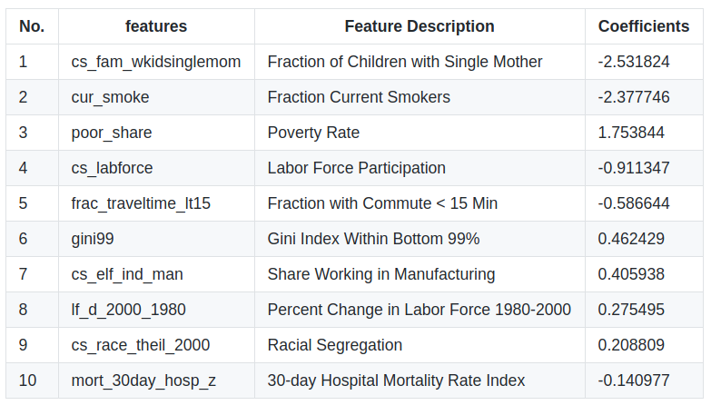
Result of Regularization with Lasso model
Notes:
We can select features by compute the feature importances with Random Forests model. Here we check with the best Random forests model discussed before.

Slide 44
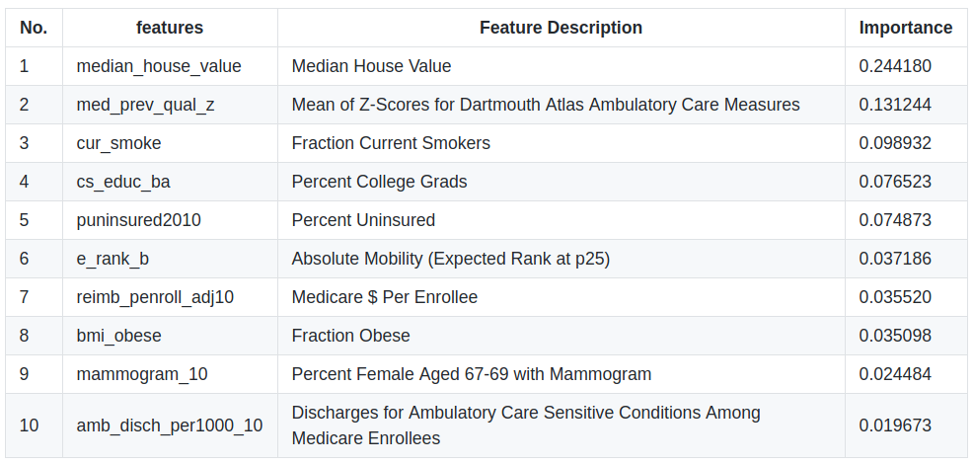
Result of Random Forests Regressor model
Notes:
We can select features by compute the feature importances with Random Forests model. Here we check with the best Random forests model discussed before.

Slide 45
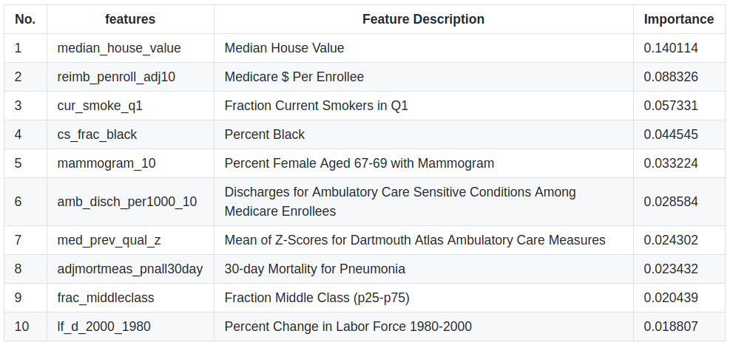
Factors affect life expectancy of people with bottom quartile income
Notes:
We can select features by compute the feature importances with Random Forests model. Here we check with the best Random forests model discussed before.

Slide 46
Analysis Results
Higher income was associated with longer life expectancy throughout the income distribution. The gap in life expectancy between the richest 1% and poorest 1% of individuals was 14.6 years for men and 10.1 years for women.
Life expectancy of women is higher than life expectancy of men in the same income percentile. Gender gap of life expectancy decreased with higher income percentile. It's 6.0 for the poorest 1% and 1.5 for the richest 1% of individuals.
Inequality in life expectancy increased over time. Between 2001 and 2014, life expectancy increased by 2.4 years for men and 2.7 years for women in the top 1% of the income distribution, but decreased by 0.1 years for men and women in the bottom 1%.
Life expectancy for low-income individuals varied substantially across local areas. In the bottom income quartile, California and New York have the highest life expectancy while Indiana and Oklahoma have the lowest life expectancy. The difference is about 3~4 years.
Geographic differences in life expectancy for individuals in the United States were significantly correlated with income inequality, health behaviors such as smoking and obese, access to medical care, education, and health status. Life expectancy for low-income individuals was correlated with Percent Black, Fraction Middle Class, and labor market conditions as well.
Notes:
In this project, we did some research on factors associated with differences in Life Expectancy in the United States. Main outcomes and measures of us are: Relationship between income and life expectancy; trends in life expectancy by income group; geographic variation in life expectancy levels and trends by income group; and factors associated with differences in life expectancy across areas.
From the research and analysis, we get the following results:

Slide 47

Future Work
Do factors associated with life expectancy change by year?
Collect data of 2015~2017 and do the research again.
In areas with low life expectancy or high gap of life expectancy, improve the factors affect life expectancy most and check the result.

Slide 48

Thank You!

